Slide 1

Food Park Restaurant

Slide 2
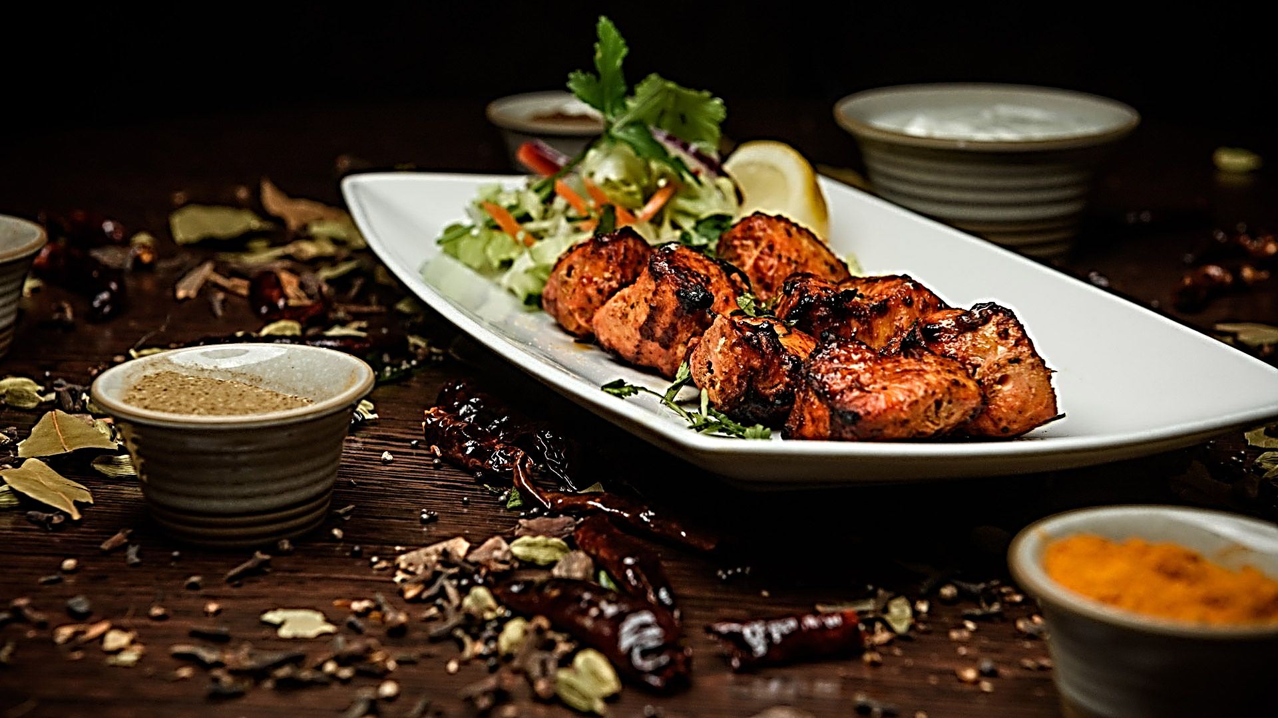
ABSTRACT
The database schema organizes data in such a way that it will help to support various features and functionalities of the restaurant management system, organize store all types of information required for the operational purpose as well by decision-making requirements.

Slide 3
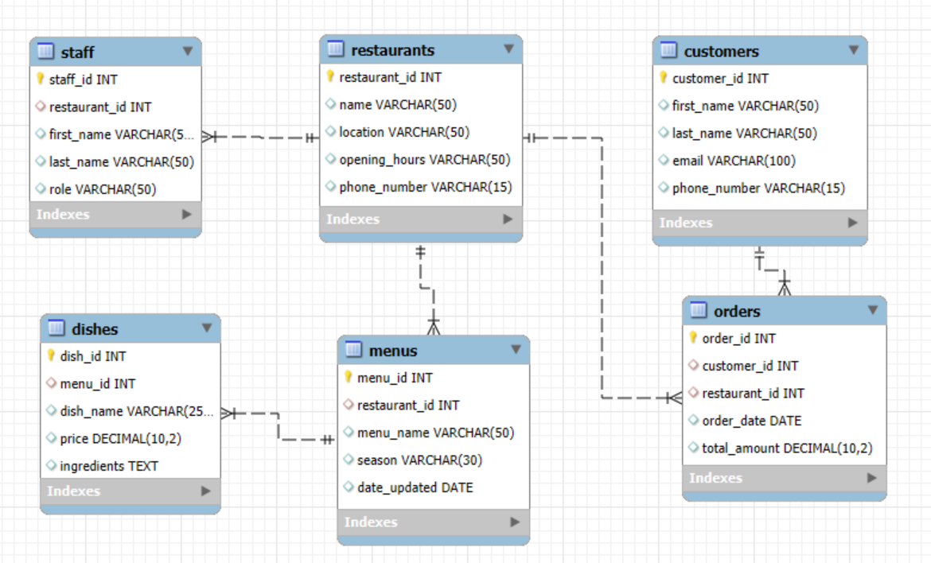
ER Diagram

Slide 4
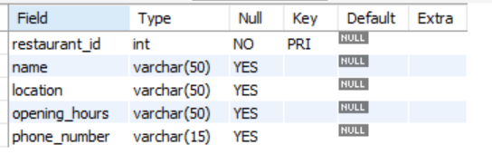
STRUCTURE OF TABLE
RESTAURANTS TABLE
SYNTAX: DESC RESTAURANTS;

Slide 5
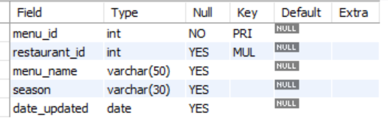
STRUCTURE OF TABLE
MENUS TABLE
SYNTAX: DESC MENUS;

Slide 6

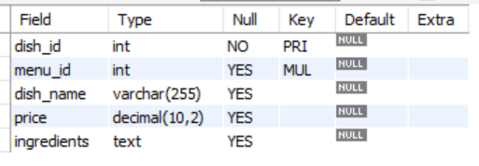
STRUCTURE OF TABLE
DISHES TABLE
SYNTAX: DESC DISHES;

Slide 7

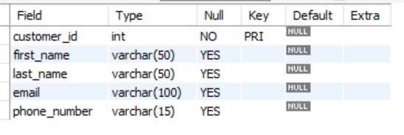
STRUCTURE OF TABLE
CUSTOMERS TABLE
SYNTAX: DESC CUSTOMERS;

Slide 8

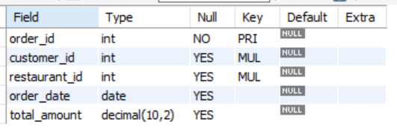
STRUCTURE OF TABLE
ORDERS TABLE
SYNTAX: DESC ORDERS;

Slide 9
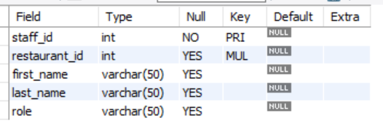
STRUCTURE OF TABLE
STAFF TABLE
SYNTAX: DESC STAFF

Slide 10
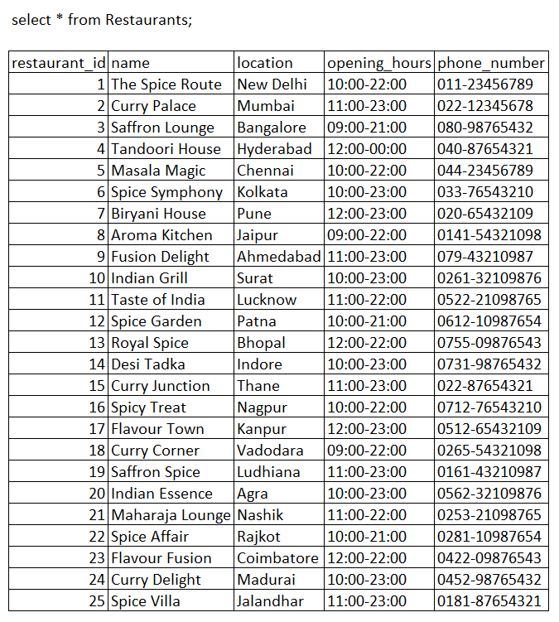
CONTENTS OF TABLE

Slide 11
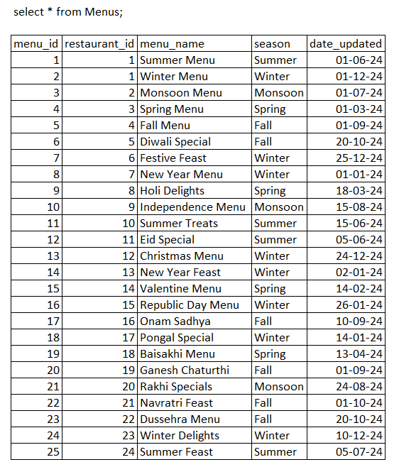
CONTENTS OF TABLE

Slide 12
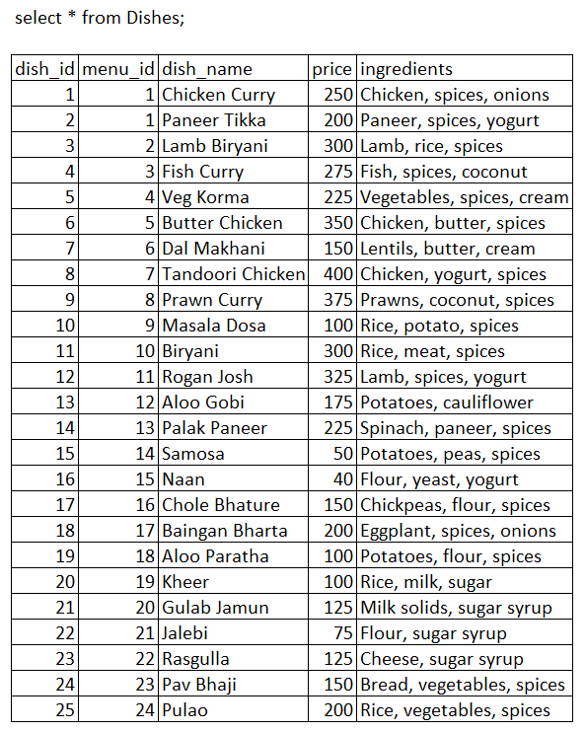
CONTENTS OF TABLE

Slide 13
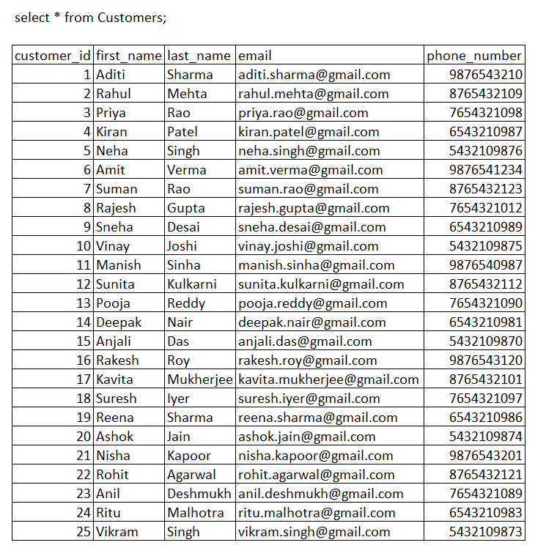
CONTENTS OF TABLE

Slide 14
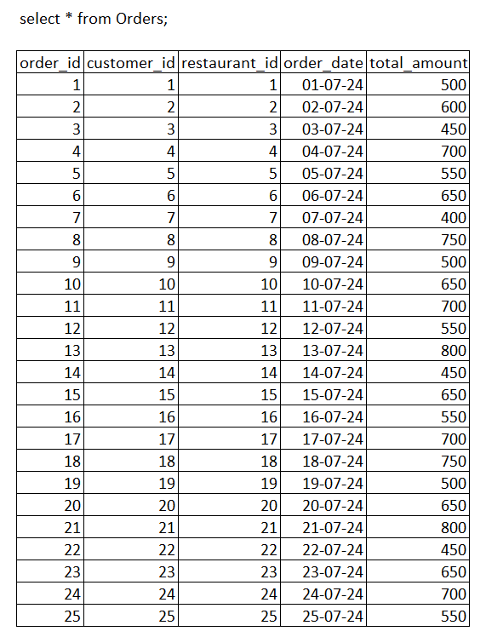
CONTENTS OF TABLE

Slide 15
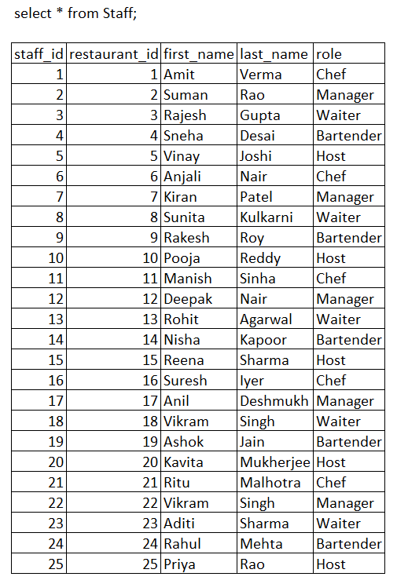
CONTENTS OF TABLE

Slide 16
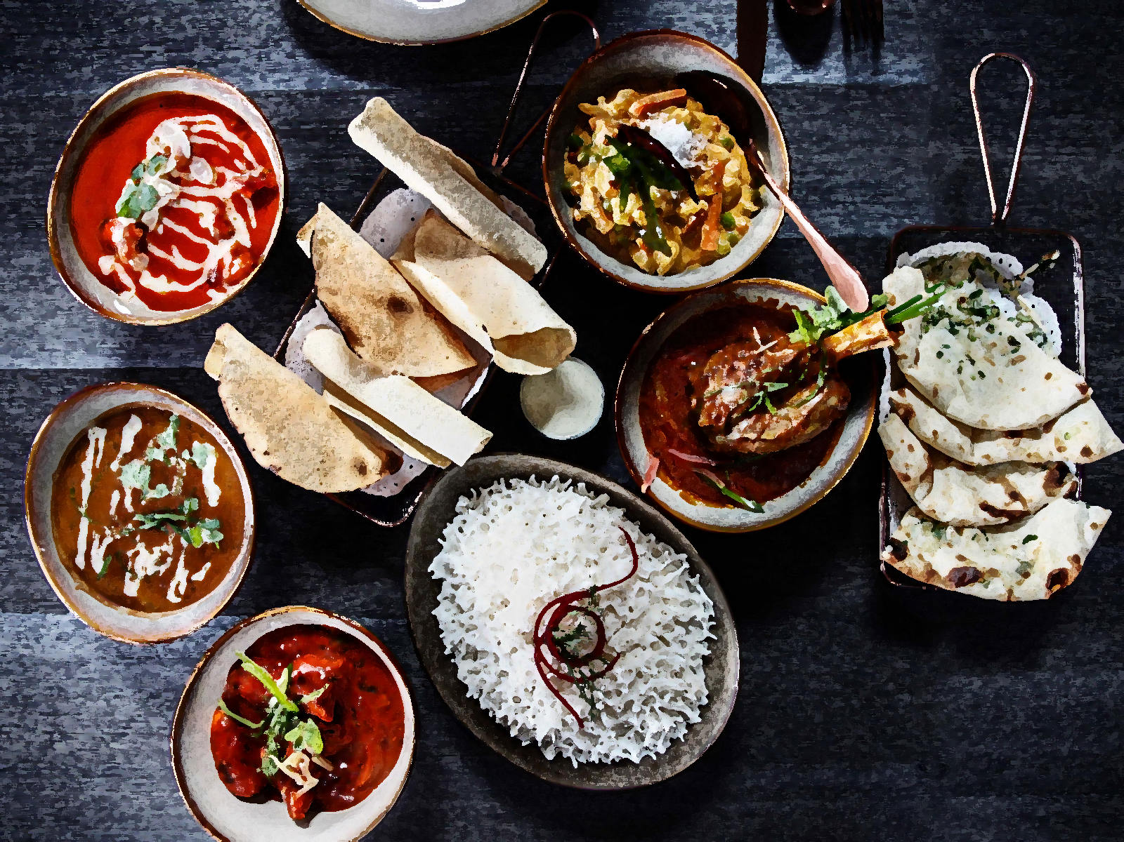
SUB QUERIES

Slide 17
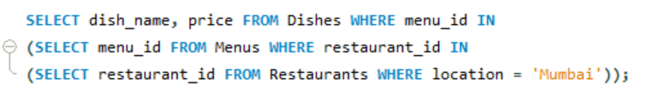
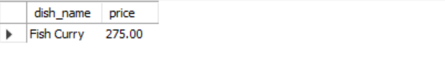
SUBQUERY
DISPLAY DISHES AND PRICE THAT ARE AVAILABLE IN THE MENU OF RESTAURANTS LOCATED IN 'MUMBAI’.
SYNTAX:
SELECT dish_name, price FROM Dishes WHERE menu_id IN (SELECT menu_id FROM Menus WHERE restaurant_id IN (SELECT restaurant_id FROM Restaurants WHERE location = 'Mumbai'));

Slide 18
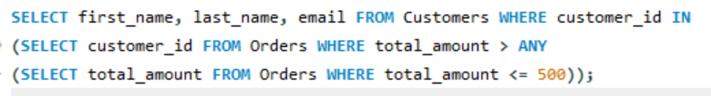
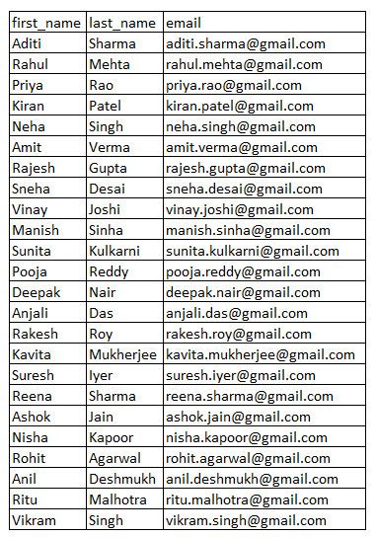
SUBQUERY
FIND ALL CUSTOMERS WHO HAVE PLACED AT LEAST ONE ORDER WITH A TOTAL AMOUNT LESS THAN RS 500.
SYNTAX:
SELECT first_name, last_name, email FROM Customers WHERE customer_id IN (SELECT customer_id FROM Orders WHERE total_amount > ANY (SELECT total_amount FROM Orders WHERE total_amount <= 500));

Slide 19
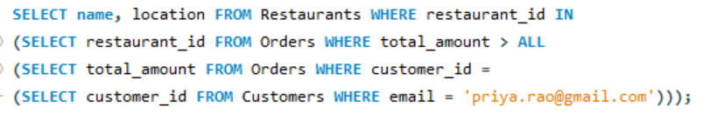
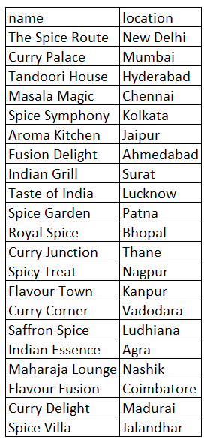
SUBQUERY
LIST ALL RESTAURANTS WHERE THE TOTAL AMOUNT OF ORDERS IS GREATER THAN THE TOTAL AMOUNT OF ORDERS PLACED BY A SPECIFIC CUSTOMER, E.G., 'PRIYA.RAO@GMAIL.COM’.
SYNTAX:
SELECT name, location FROM Restaurants WHERE restaurant_id IN (SELECT restaurant_id FROM Orders WHERE total_amount > ALL (SELECT total_amount FROM Orders WHERE customer_id = (SELECT customer_id FROM Customers WHERE email = 'priya.rao@gmail.com')));

Slide 20
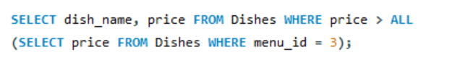
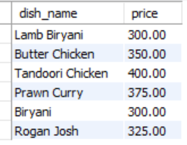
SUBQUERY
LIST THE DISHES THAT ARE PRICED HIGHER THAN ALL DISHES ON A SPECIFIC MENU, E.G., MENU_ID 3.
SYNTAX:
SELECT dish_name, price FROM Dishes WHERE price > ALL (SELECT price FROM Dishes WHERE menu_id = 3);

Slide 21
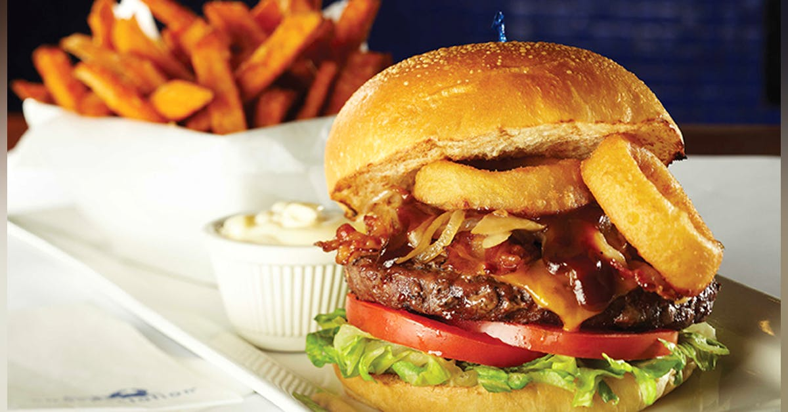
.
JOINS

Slide 22
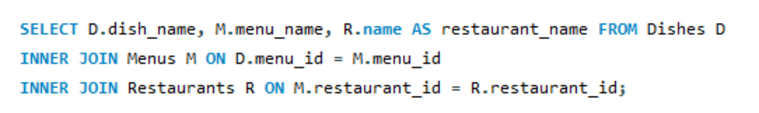
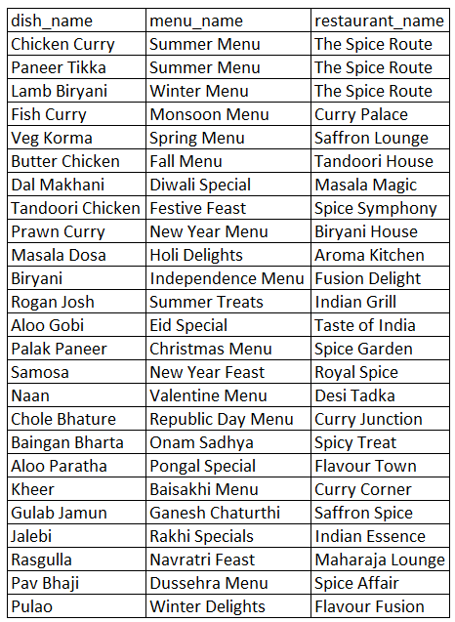
JOINS
LIST ALL DISHES ALONG WITH THEIR MENU NAMES AND RESTAURANT NAMES.
SYNTAX:
SELECT D.dish_name, M.menu_name, R.name AS restaurant_name FROM Dishes D INNER JOIN Menus M ON D.menu_id = M.menu_id INNER JOIN Restaurants R ON M.restaurant_id = R.restaurant_id;

Slide 23
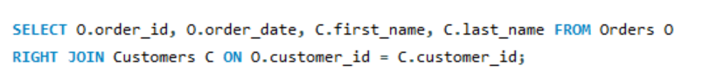
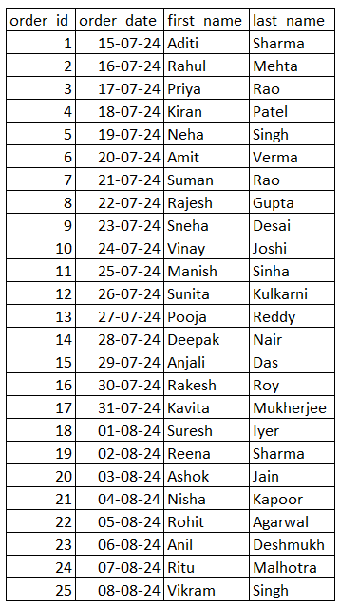
JOINS
LIST ALL ORDERS AND THE CUSTOMERS WHO PLACED THEM.
SYNTAX:
SELECT O.order_id, O.order_date, C.first_name, C.last_name FROM Orders O RIGHT JOIN Customers C ON O.customer_id = C.customer_id;

Slide 24
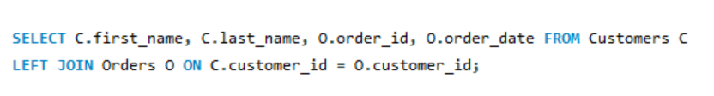
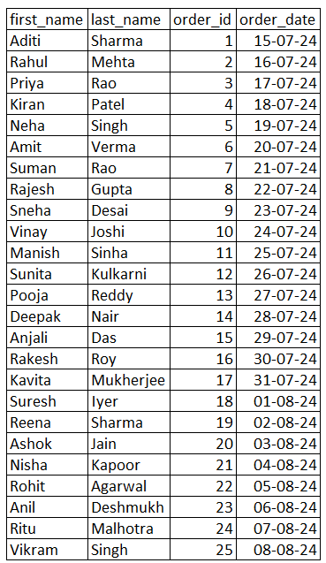
JOINS
Retrieve all customers and any orders they have placed.
SYNTAX:
SELECT C.first_name, C.last_name, O.order_id, O.order_date FROM Customers C LEFT JOIN Orders O ON C.customer_id = O.customer_id;

Slide 25
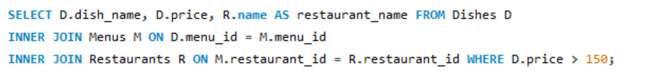
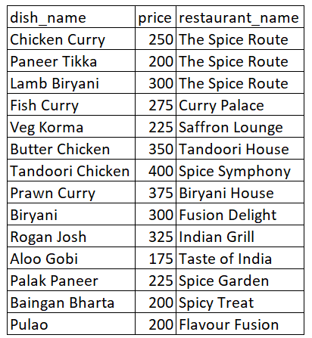
JOINS
GET A LIST OF DISHES, THEIR PRICES, AND THE NAMES OF THE RESTAURANTS WHERE THEY ARE SERVED, BUT ONLY FOR DISHES PRICED ABOVE RS 150.
SYNTAX:
SELECT D.dish_name, D.price, R.name AS restaurant_name FROM Dishes D INNER JOIN Menus M ON D.menu_id = M.menu_id INNER JOIN Restaurants R ON M.restaurant_id = R.restaurant_id WHERE D.price > 150;

Slide 26
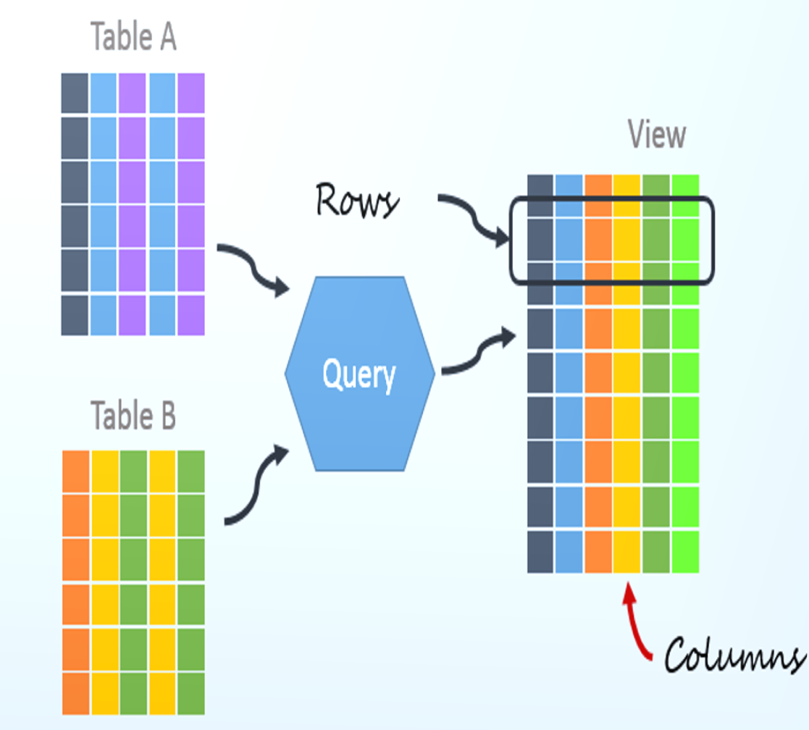
.
VIEW

Slide 27
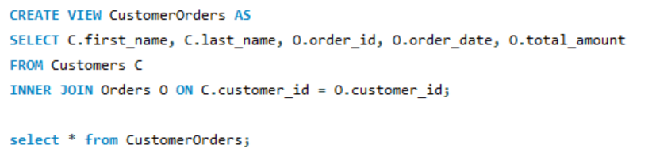
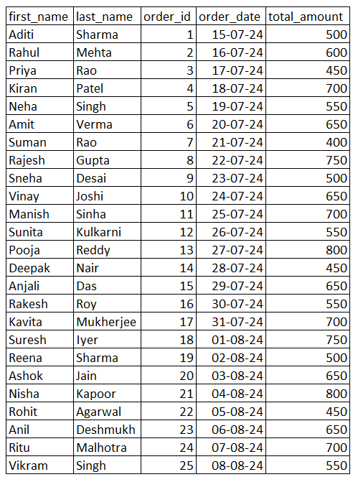
VIEWS
CREATE A VIEW THAT SHOWS CUSTOMER NAMES ALONG WITH THEIR ORDERS AND THE TOTAL AMOUNT SPENT.
SYNTAX:
CREATE VIEW CustomerOrders AS SELECT C.first_name, C.last_name, O.order_id, O.total_amount FROM Customers C INNER JOIN Orders O ON C.customer_id = O.customer_id;
SELECT * from CustomerOrders;

Slide 28
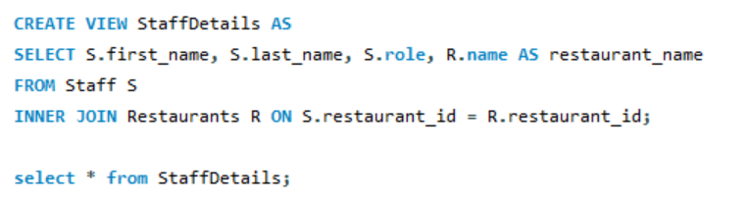
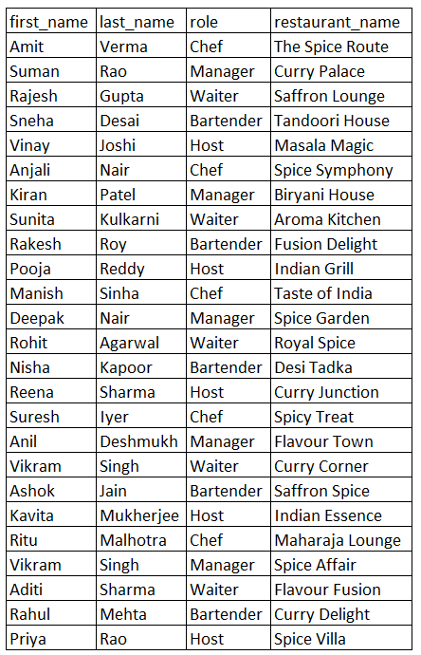
VIEWS
CREATE A VIEW THAT DISPLAYS STAFF MEMBERS ALONG WITH THEIR ROLES AND THE RESTAURANT THEY WORK AT.
SYNTAX:
CREATE VIEW StaffDetails AS SELECT S.first_name, S.last_name, S.role, R.name AS restaurant_name FROM Staff S INNER JOIN Restaurants R ON S.restaurant_id = R.restaurant_id;
select * from StaffDetails;

Slide 29
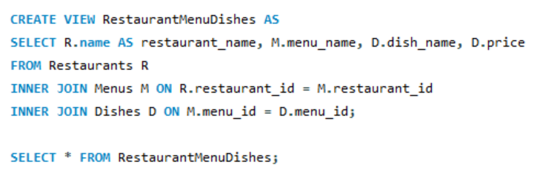
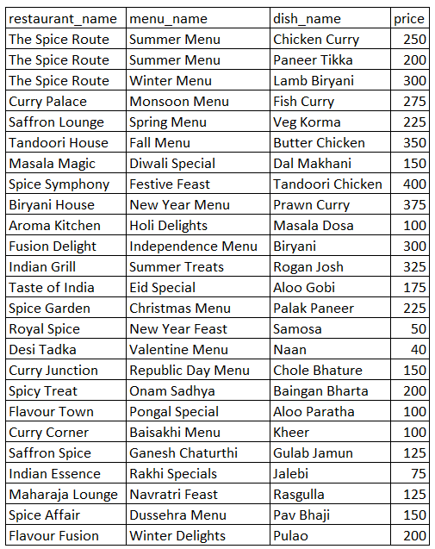
VIEWS
CREATE A VIEW THAT SHOWS ALL RESTAURANT NAMES, THEIR MENU NAMES, AND THE DISHES ON THOSE MENUS.
SYNTAX:
CREATE VIEW RestaurantMenuDishes ASSELECT R.name AS restaurant_name, M.menu_name, D.dish_name, D.priceFROM Restaurants R INNER JOIN Menus M ON R.restaurant_id = M.restaurant_id INNER JOIN Dishes D ON M.menu_id = D.menu_id;
SELECT * FROM RestaurantMenuDishes;

Slide 30
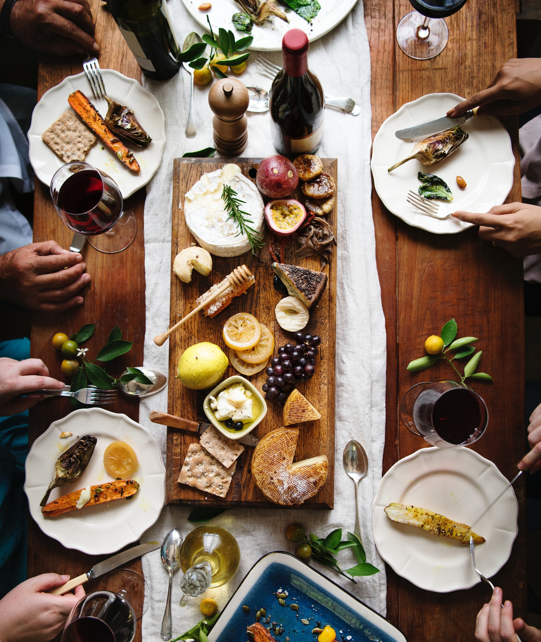
.
PREPARED BY:
JAY VICHARE
IT VEDANT

Slide 31
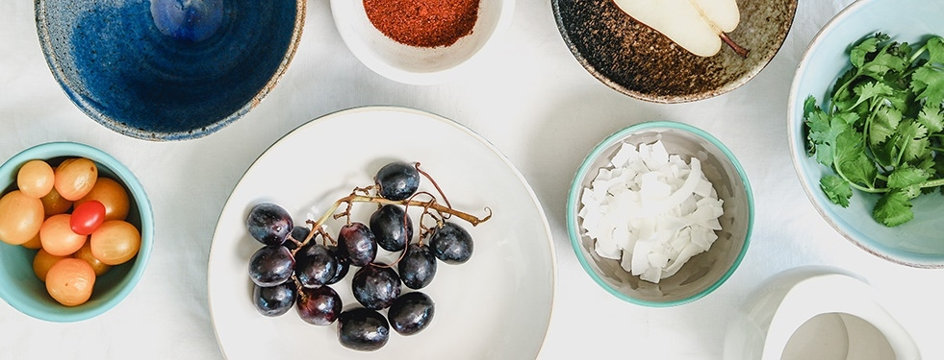
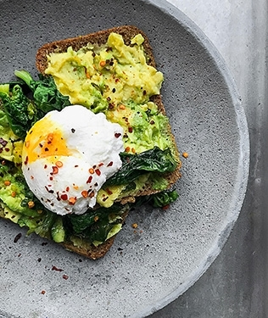
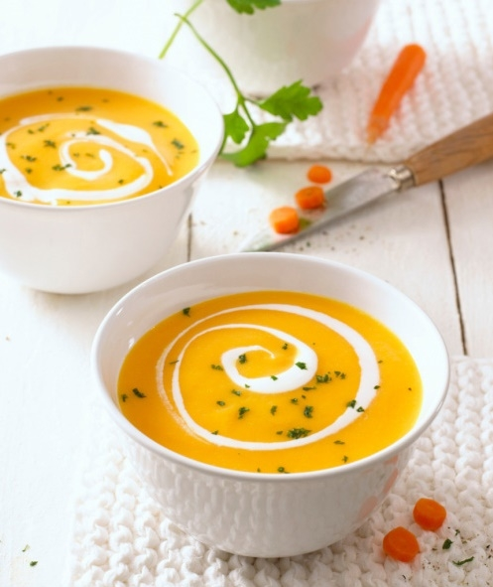
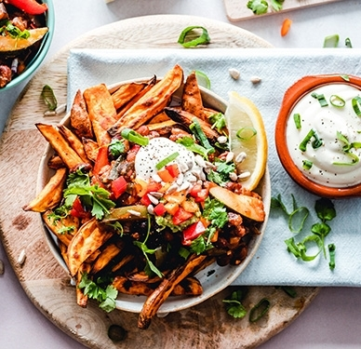
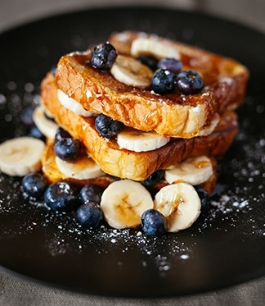
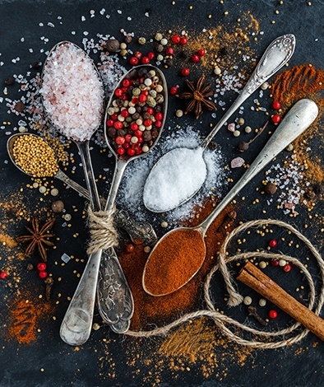
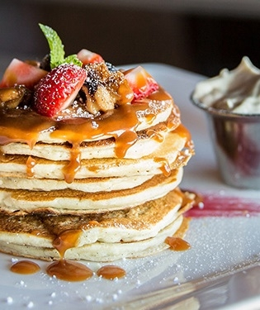
THANK YOU
THANK YOU

